Slide 1
Introduction to Real-Time Simulation with NetLogo
A Step-by-Step Guide

Slide 2
System Requirements
• Operating System: Windows, macOS, or Linux.
• Java Runtime Environment (JRE) 8 or later.
• Processor: 2 GHz dual-core or better.
• RAM: 4 GB minimum (8 GB recommended).
• Storage: At least 300 MB of free space.
Notes:
In this slide, we're outlining the basic system requirements for running NetLogo.
Ensure your system meets these requirements before attempting installation.
Most modern systems should have no trouble running NetLogo.
Java Runtime Environment is crucial as NetLogo is built on Java.

Slide 3
Where to Download NetLogo
• Visit the official website: https://ccl.northwestern.edu/netlogo/
• Choose the installer for your operating system (Windows, macOS, Linux).
• Download and save the installer to your computer.
Notes:
This slide provides the official download link for NetLogo.
Ensure you're downloading from the official site to avoid any security risks.
The website will automatically detect your operating system and suggest the appropriate installer.

Slide 4
How to Install NetLogo
• Windows: Run the .exe file and follow on-screen instructions.
• macOS: Open the .dmg file, drag NetLogo to Applications.
• Linux: Extract the .tar.gz file, run the NetLogo executable.
You can also run NetLogo in a browser got to NetLogo Web
Notes:
This slide outlines the basic installation steps for NetLogo on various operating systems.
Each operating system has a slightly different installation process, but they are all straightforward.
For Windows and macOS, it's mostly a matter of clicking through prompts, while Linux may require command-line usage.

Slide 5
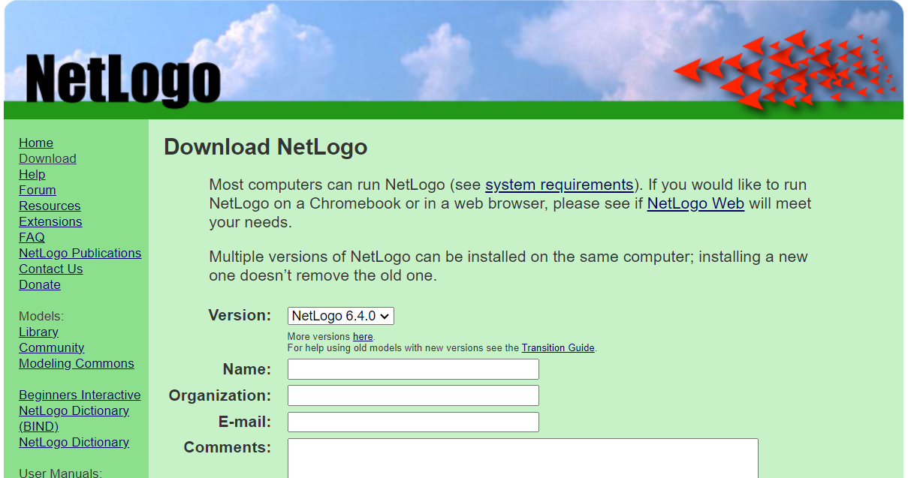
Notes:
This slide should contain a screenshot of the NetLogo download page.
Use this to show users exactly where to click to download the installer.

Slide 6
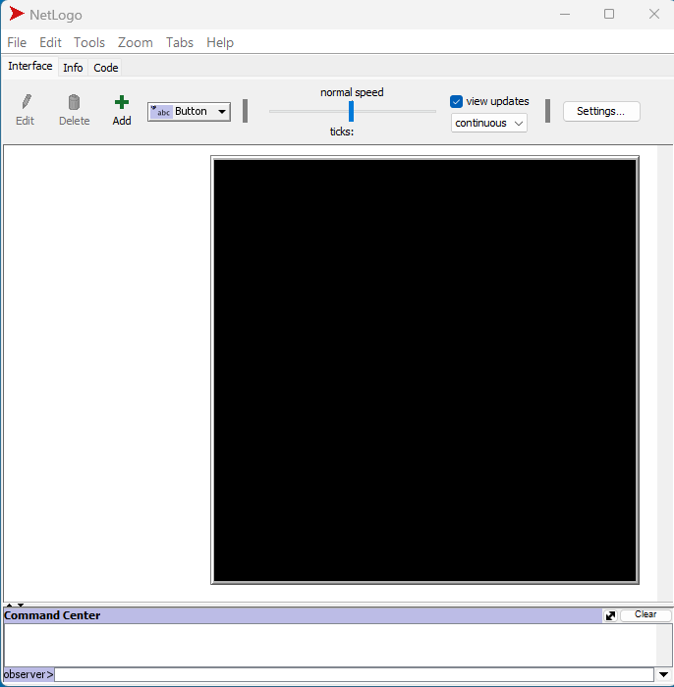
Exploring the Interface
When you first open NetLogo, you'll see the main interface divided into several areas:
Menu Bar: Contains File, Edit, Tools, Zoom, and Help options
Toolbar: Quick access to common actions like New, Open, Save
Tabs: Interface, Info, and Code tabs
Command Center: At the bottom, where you can enter commands directly

Slide 7
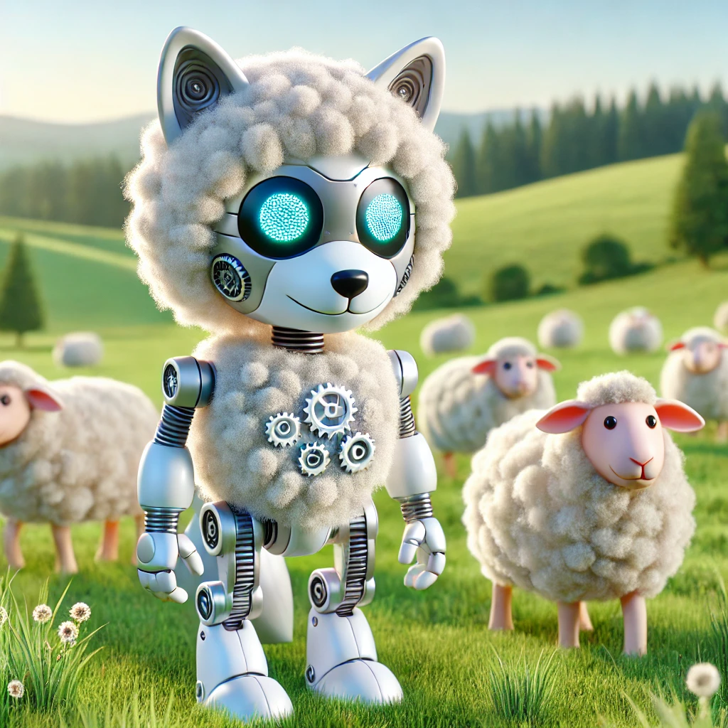
Your First Model: Wolf Sheep Predation
Let's explore a pre-built model to get familiar with NetLogo:
Click on "File" in the menu bar
Select "Models Library"
In the library, navigate to "Biology" > "Wolf Sheep Predation"
Click "Open"
You'll see the model interface with various buttons, sliders, and graphs.

Slide 8

Running the Simulation
Click the "setup" button to initialize the simulation
Click "go" to start the simulation
Observe how the wolf and sheep populations change over time

Slide 9

Viewing the Code
Click on the "Code" tab
Here you can see the NetLogo code that defines the model's behavior
Don't worry if you don't understand everything yet – we'll get there!

Slide 10
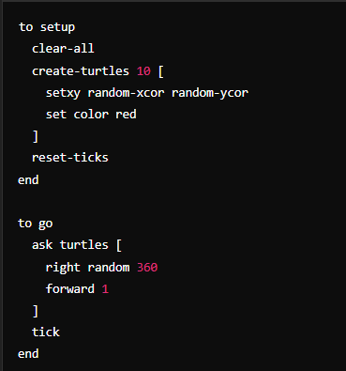
Creating Your First Simple Model
Let's create a very simple model from scratch:
Click "File" > "New“
In the Code tab, enter the code (Arduino) from the image
Switch to the Interface tab
Add two buttons:
Click "Button" in the toolbar
Click in the interface to place the button
In the dialog, enter "setup" for the first button and "go" for the second
Check "Forever" for the "go" buttonClick "setup", then "go" to run your first custom simulation!

Slide 11
For Python 1 of 2
Install Necessary Libraries:
Make sure you have Python installed. You can install any additional libraries if needed, but Turtle is usually built-in.
Install numpy
Writing the Simulation Code in Python:Open your preferred Python editor or IDE (e.g., VSCode, PyCharm).
Enter the Python code to create a simple simulation written in the next slide

Slide 12
For Python 2 of 2
import turtle
import random
# Setup the screen
screen = turtle.Screen()
screen.bgcolor("black")
# Function to setup turtles
def setup_turtles(num_turtles):
turtles = []
for _ in range(num_turtles):
new_turtle = turtle.Turtle()
new_turtle.shape("turtle")
new_turtle.color("red")
new_turtle.penup()
new_turtle.speed(0)
new_turtle.goto(random.randint(-200, 200), random.randint(-200, 200))
turtles.append(new_turtle)
return turtles
# Function to move turtles
def move_turtles(turtles):
for t in turtles:
t.right(random.randint(0, 360))
t.forward(10)
# Setup the turtles
turtles = setup_turtles(10)
# Run the simulation
while True:
move_turtles(turtles)
This Python code uses the turtle library to create a simple simulation.
Turtle Graphics: The turtle module allows you to create graphics programs.
setup_turtles function: Creates and initializes a group of turtles, each representing an agent in the simulation.
move_turtles function: Moves the turtles randomly in the simulation area.
The simulation runs indefinitely, mimicking a simple agent-based model.

Slide 13

Running the Simulation
Save the Python code as turtle_simulation.py.
Run the script, and you'll see multiple turtles moving randomly on the screen, simulating a simple model.

Slide 14
Next Steps - NetLogo
In NetLogo:
Complete the built-in NetLogo tutorial:
Help > TutorialExplore more models in the Models Library
Read the NetLogo User Manual: Help > NetLogo User Manual
Join the NetLogo Users Group: https://groups.google.com/g/netlogo-users
In Python:
Experiment with the turtle library in Python to create more complex simulations.
Explore libraries like pygame for more advanced graphics and simulations.
Learn to integrate simulations with data analysis tools like numpy and matplotlib.

Slide 15
Conclusion
Congratulations:
You've taken your first steps with both NetLogo and Python. Keep experimenting and building more complex models to deepen your understanding of agent-based modeling and simulation.
NetLogo is a versatile tool for simulations.
Ensure your system meets the requirements.
Download and install from the official site.
Notes:
To wrap up, remember that NetLogo is a powerful tool that can be installed on most modern systems.
Always download from the official website to ensure you have the latest and safest version.

